Slide 1


Phishing Proof: Building a Human Firewall
A Cyber security internship task by uday charan kadulla
Presented for: CodeAlpha Internship Program

Slide 2
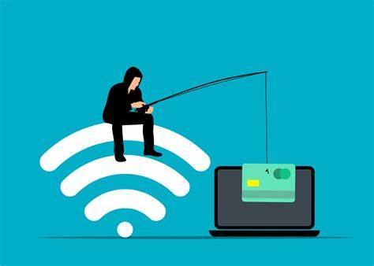
What is Phishing?
Phishing is a type of cyber attack where criminals impersonate trusted entities to trick individuals into revealing sensitive information such as passwords, credit card numbers, or personal details.
These attacks usually come through fake emails, messages, or websites designed to look legitimate. They often use psychological tactics like urgency, fear, or curiosity to pressure users into clicking malicious links or providing confidential data.
Key Traits of Phishing:
Disguised as trusted communication (e.g., bank, employer, government)
Creates urgency (e.g., “Your account will be locked”)
Leads to data theft or malware installation

Slide 3
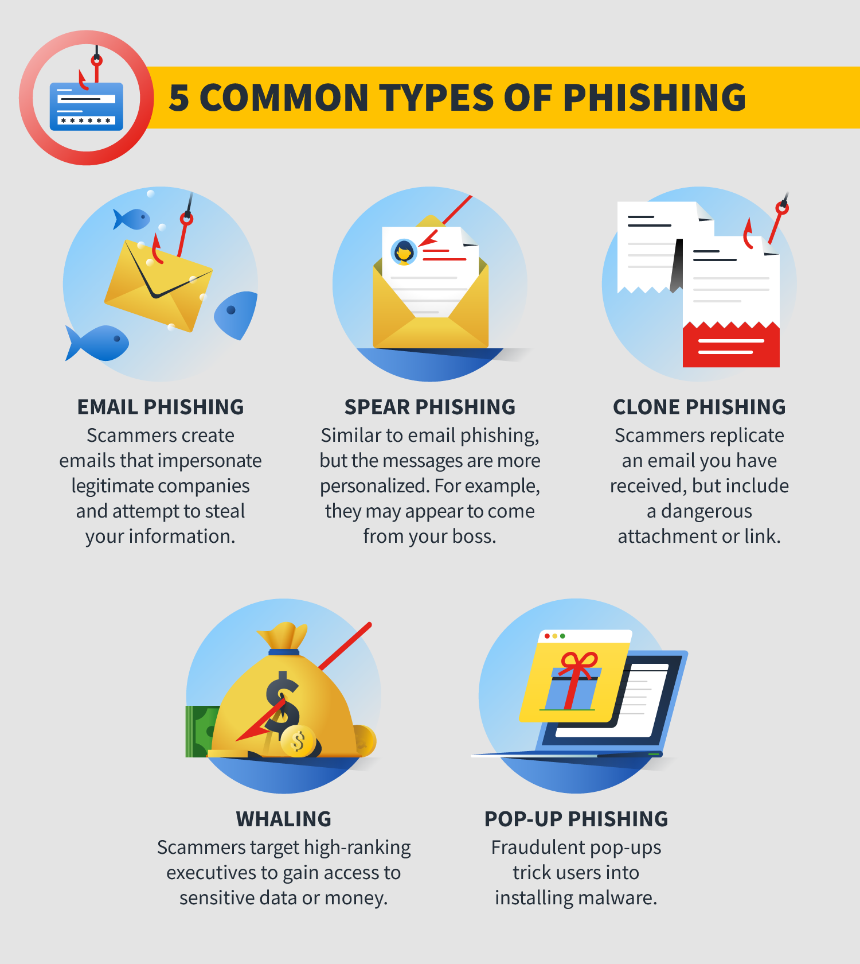
Types of Phishing Attacks!!
1. Email Phishing
The most common form — attackers send mass emails pretending to be from trusted sources, asking users to click malicious links or download harmful attachments.
2. Spear Phishing
Highly targeted — attackers research specific individuals and craft personalized messages to trick them into giving up sensitive information.
3. Smishing (SMS Phishing)
Phishing through text messages — fake alerts or offers sent via SMS that urge users to click harmful links.
4. Vishing (Voice Phishing)
Phishing through phone calls — attackers pretend to be officials from banks, tech support, etc., and ask for confidential details.
5. Clone Phishing
Attackers create a near-identical copy of a legitimate email that the victim previously received, but with a malicious link or attachment.

Slide 4
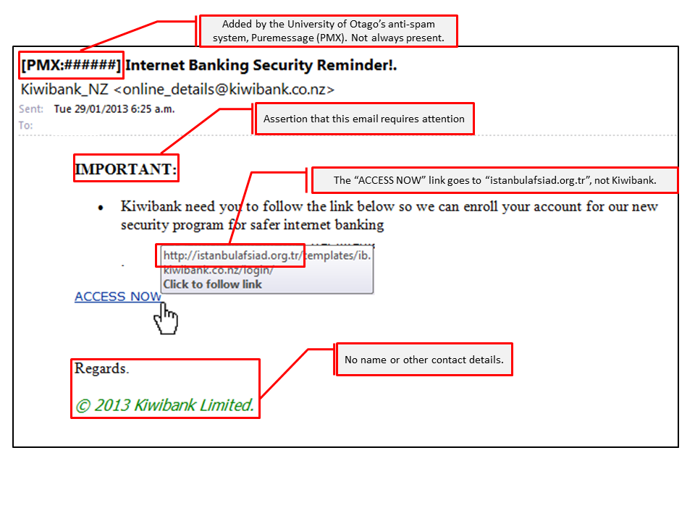
How to Recognize Phishing
❌ Suspicious sender address (e.g., support@paypa1.com)
❌ Spelling and grammar mistakes
❌ Generic greetings like “Dear User” or “Valued Customer”
❌ Links that don’t match the real site (hover to check!)
❌ Urgent threats like “Account will be blocked in 24 hrs!”
❌ Unexpected attachments or pop-ups

Slide 5
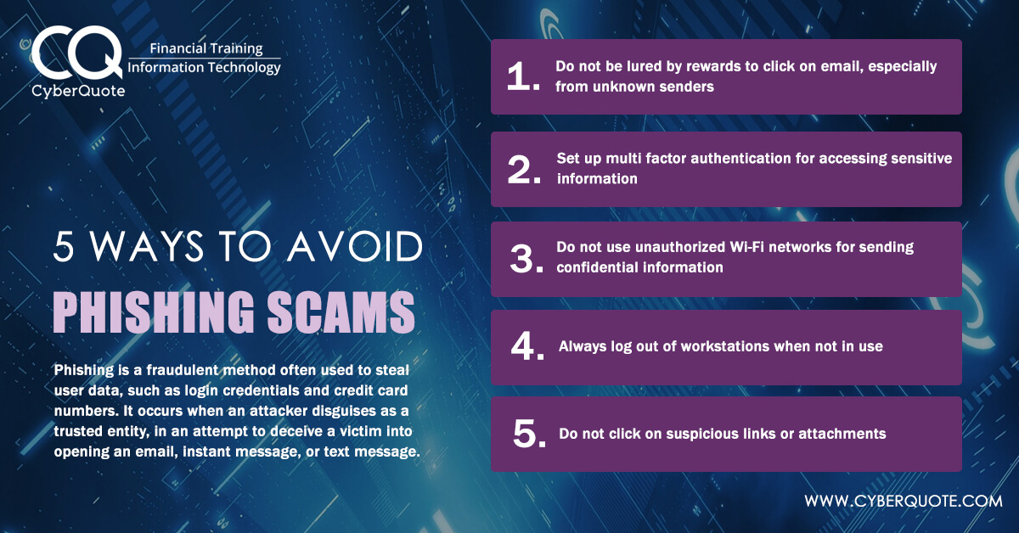
Best Practices To Avoid Phishing
Be
Be wary of unsolicited requests: Never provide personal information in response to an unsolicited request, whether it is over the phone or the Internet.
Think
Think before you click: Be wary of messages that implore you to act immediately, offer something that sounds too good to be true, or ask for personal or financial information.
Verify
Verify the sender: Check the sender's email address. Ensure the domain matches the organization it claims to be from. Be cautious of generic greetings.
Inspect
Inspect links: Hover over links to reveal the full address. If it looks suspicious, don't click it. Instead, use a reputable search engine to get to the site or type the URL directly into your browser.
Don't open
Don't open suspicious attachments: Be cautious of attachments, especially from unfamiliar senders or if the attachment has an unusual extension.
Look
Look for red flags: Watch out for spelling and grammatical errors, a sense of urgency, and requests for personal information.
Keep
Keep software up to date: Ensure your devices are equipped with regularly updated antivirus software, firewalls, email filters, and anti-spyware.
Use
Use strong passwords: Combine capital and lowercase letters with numbers and symbols to create a more secure password.
Enable
Enable multi-factor authentication (MFA): Use MFA to help verify authorized access to online accounts.
Report
Report suspicious activity: If you suspect a phishing attempt, report it to the relevant authorities, such as the FTC.

Slide 6
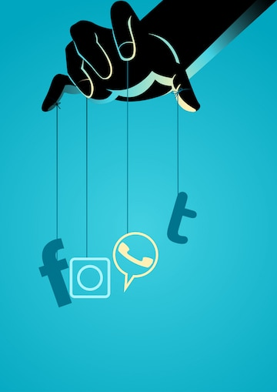
Social Engineering Tactics
Phishing works by manipulating human behavior, not just technology.
Common tactics:
Fear/Urgency: "Account blocked!"
Reward: "You’ve won a voucher!"
Authority: "From your bank CEO"
Curiosity: "See who viewed your profile"

Slide 7
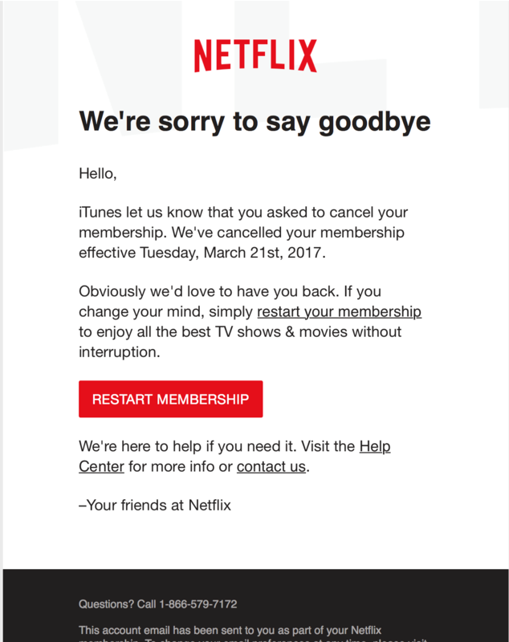
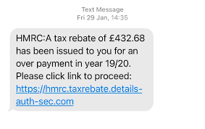
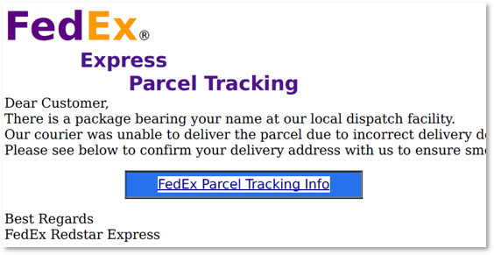
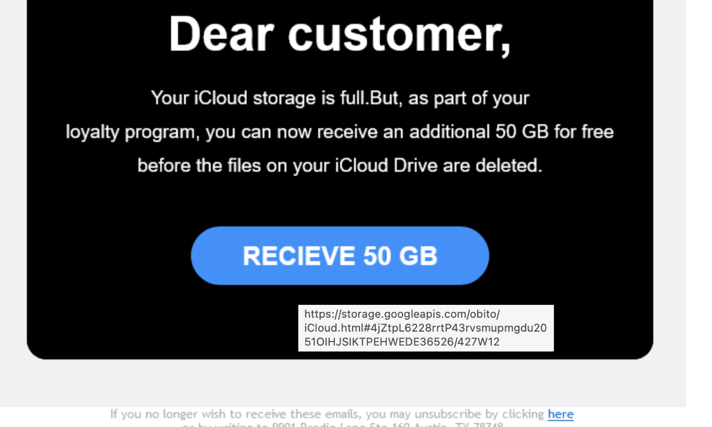
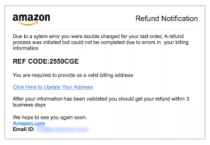
Real World Examples

Slide 8
Tools to Detect Phishing
Top Tools:
PhishTank – Real-time phishing database
VirusTotal – Scans URLs/files
Google Safe Browsing
WOT (Web of Trust)
Gmail/Outlook Spam Filters

Slide 9


Conclusion: Stay Alert, Stay Protected
Phishing remains one of the most common and dangerous cyber threats, targeting not just technology — but people. These attacks are designed to trick you, but with awareness and caution, they can be easily avoided.
Think before you click — always inspect links and email addresses.
Don’t trust urgency blindly — pause and verify.
Report suspicious messages to your IT/security team.
Educate others — awareness is the first line of defense.
“Cybersecurity isn’t just an IT issue — it’s everyone’s responsibility.”
Together, let’s build a human firewall. Thank you!

Slide 10

References
https://www.interpol.int/en/Crimes/Cybercrime
https://www.cyber.gov.au
https://www.kaspersky.com/resource-center/threats/phishing
https://us.norton.com/blog/emerging-threats/phishing

